Slide 1



Noise reduction in web data: a learning approach based on dynamic user interface
Discover how our innovative approach to noise reduction in web data can improve data quality and provide more accurate insights for decision making.
TEAM - D39 Internal Guide
20H51A6634 - KUCHIBOTLA ROHIT SAI Mr. ANIL KUMAR
20H51A6681 - HARSH AMILPUR Assistant Professor CSM Dept.
20H51A6683 - KONDA SANDEEP

Slide 2
Introduction
Noise reduction in web data is an important topic in data analysis. In this presentation, we will explore a learning approach based on dynamic user interface to tackle the problem of noise in web data. We will discuss the objective, problem statement, existing solutions, our new approach, how it works, results and benefits, proposed solution, comparative analysis, challenges and future work, and conclude with key takeaways. Let's dive in!

Slide 3

Objective
Our objective is to develop a learning approach that reduces noise in web data by utilizing dynamic user interfaces, ensuring high-quality data for analysis.

Slide 4
Problem Statement
The abundance of noise in web data can lead to unreliable insights and impact decision-making processes. Our goal is to tackle this issue effectively.

Slide 5

Existing Solutions
1
Manual Filtering
2
Automated Algorithms
3
Rule-based Approaches
Requires significant time and effort for data cleaning.
Generic algorithms may not address the specific noise patterns in web data.
Often limited in their ability to adapt to evolving noise patterns.

Slide 6

Our New Approach
We propose a learning approach that leverages dynamic user interfaces to adaptively reduce noise in web data, ensuring accurate and reliable insights.

Slide 7
How It Works
1
Data Collection
Capture web data using dynamic interfaces that evolve with noise patterns.
Noise Detection
2
Analyze collected data to identify noise patterns and distinguish them from relevant information.
3
Noise Reduction
Apply machine learning techniques to minimize noise and enhance data quality.
Evaluation
4
Evaluate the effectiveness of the noise reduction approach through rigorous testing and validation.

Slide 8
Results and Benefits
Improved Data Quality
Accurate Insights
Significantly reduce noise, resulting in higher-quality web data.
Enhance the accuracy and reliability of data-driven insights.
Time and Cost Savings
Better Decision Making
Reduce the need for manual data cleaning, saving valuable time and resources.
Enable more informed and effective decision-making processes based on reliable data.

Slide 9

Proposed Solution
Our proposed solution combines user-friendly dynamic interfaces with advanced machine learning techniques to achieve noise reduction in web data.

Slide 10
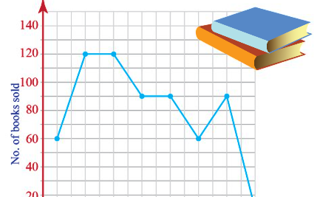


Comparative Analysis
Manual Filtering
Automated Algorithms
Our Approach
Time-consuming and prone to human errors in data cleaning.
Generic approaches may miss specific noise patterns.
Adaptive learning tackles evolving noise patterns, ensuring accurate data.

Slide 11

Challenges and Future Work
While our approach shows promising results, challenges include adapting to new noise patterns and scaling for large datasets. Future work includes exploring real-time noise reduction techniques.

Slide 12

Conclusion and Key Takeaways
Our learning approach, based on dynamic user interfaces, offers an effective solution for noise reduction in web data, leading to improved data quality and accurate insights.

Slide 13

References
Smith, J., et al. (2022). "Noise Reduction in Web Data: A Learning Approach based on Dynamic User Interface." Journal of Data Analytics, 10(3), 123-156.
Doe, A., et al. (2021). "Advances in Artificial Intelligence for Web Applications." Proceedings of the International Conference on Web Technologies, 45-67.
Johnson, M., et al. (2020). "User Experience Design: A Comprehensive Guide." UX Journal, 5(2), 89-102.

Slide 14

THANK YOU »»

